Slide 1

00 — Thumbnail
Java Course
Clean Code & Design Principles
IIRINA FIODOROVA - DEVELOPER

Slide 2
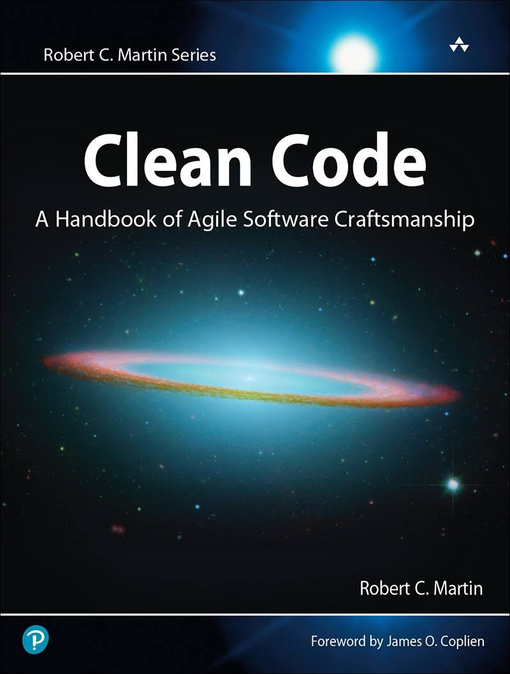

00 — Slide Title
Clean Code
Book by Robert Cecil Martin
Clean code refers to code that is easy to read, understand, and maintain. It follows programming best practices such as having descriptive variable names, consistent indentation, and clear structure.
Clean code also minimizes complexity and reduces the likelihood of bugs. The goal is to write code that is both functional and sustainable in the long-term.

Slide 3
00 — Slide Title
Names rules
Choose descriptive and unambiguous names.
Make meaningful distinction.
Use pronounceable names.
Use searchable names.
Replace magic numbers with named constants.
Avoid encodings. Don't append prefixes or type information.

Slide 4

00 — Slide Title
Classes names
DON’TS
DO’s
"Class1", "Class2", "Class3"
"Data", "Object", "Entity"
"Info", "Detail", "Record"
"Module", "System", "Process"
"Customer"
"Employee"
"Order"
"Product"
"Invoice"
Notes:
Guidelines for creating meaningful and descriptive names:
Use descriptive and specific terms that clearly convey the purpose or meaning of the element being named (variable, class, method, etc.).
Avoid abbreviations, unless they are widely recognized and commonly used (e.g. "ID" for "identification").
Use camelCase or snake_case as appropriate, and be consistent in your naming conventions throughout the codebase.
Use nouns for class names and verbs for method names, to clearly convey their purpose.
Make sure the names are long enough to be descriptive, but not so long that they become unwieldy.
Avoid using single-letter names, except for temporary loop variables.
Avoid using the same name for multiple elements within the same scope, as it can cause confusion and errors.

Slide 5
00 — Slide Title
Variables names
DON’TS
DO’s
"x", "y", "z"
"a", "b", "c"
"temp", "flag", "result"
"num1", "num2", "num3"
"customerName"
"employeeSalary"
"totalOrderAmount"
"streetAddress"
"dateOfBirth"

Slide 6

00 — Slide Title
Methods names
DON’TS
DO’s
"doit"
"thing"
"stuff"
"run"
"process"
"calculateTotal"
"getCustomerAddress"
"processOrder"
"validateAddress"
"updateInventory"
"sendConfirmationEmail"

Slide 7
00 — Slide Title
Abbreviations – DOs
num for "number"
id for "identifier"
min for "minimum"
max for "maximum"
sum for "sum"
avg for "average"
dob for "dateOfBirth"
err for "error"
msg for "message"

Slide 8
00 — Slide Title
Abbreviations – DON’Ts
cid instead of "customerId" or oid instead of "orderId"
sa instead of "streetAddress"
temp instead of "temperature" or "temporary"
d instead of "date" or 'currentDate"

Slide 9

00 — Slide Title
Hardcoded Values
& Magic Variables

Slide 10
00 — Slide Title
Functions rules
Small.
Do one thing.
Use descriptive names.
Prefer fewer arguments.
Have no side effects.
Don't use flag arguments. Split method into several independent methods that can be called from the client without the flag.

Slide 11
00 — Slide Title
Comments rules
Always try to explain yourself in code.
Don't be redundant.
Don't add obvious noise.
Don't use closing brace comments.
Never comment out code. Just remove.
Use as explanation of intent.
Use as clarification of code.
Use as warning of consequences.

Slide 12

00 — Slide Title
Source code structure
Separate concepts vertically.
Related code should appear vertically dense.
Declare variables close to their usage.
Dependent functions should be close.
Similar functions should be close.
Place functions in the downward direction.
Keep lines short.
Don't use horizontal alignment.
Use white space to associate related things and disassociate weakly related.
Don't break indentation.

Slide 13
00 — Slide Title
Design rules
Keep configurable data at high levels.
Prefer polymorphism to if/else or switch/case.
Separate multi-threading code.
Prevent over-configurability.
Use dependency injection.
Follow Law of Demeter. A class should know only its direct dependencies.

Slide 14
00 — Slide Title
Other rules
Use appropriate data structures and algorithms to minimize complexity and improve performance.
Use descriptive and meaningful error messages, to aid in debugging and error handling.
Code is regularly refactored, to keep the code organized, maintainable, and free of technical debt.
Code is tested thoroughly, to ensure that it works as intended and that any changes can be made with confidence.
Notes:
Not recommended data structures:
Using an array to implement a data structure with frequent insertions and deletions, as this can result in slow performance and frequent resizing of the array.
Using a linked list to implement a data structure with random access, as linked lists do not support efficient random access like arrays.
Using a hash table to implement a data structure where the order of elements needs to be preserved, as hash tables do not maintain the order of elements.
Using a tree structure to implement a data structure with many relationships between elements, as trees can become very complex and difficult to manage in such cases.
Recommended data structures:
Using a stack to implement undo/redo functionality in a text editor
Using a queue to process tasks in a work queue, so that tasks are processed in the order they were received
Using a hash table for efficient lookup of values, for example for indexing words in a dictionary
Using a tree structure to efficiently search for data, for example to implement an autocomplete feature

Slide 15
00 — Slide Title
Tests
One assert per test.
Readable.
Fast.
Independent.
Repeatable.

Slide 16
00 — Slide Title
Understandability tips
Be consistent. If you do something a certain way, do all similar things in the same way.
Use explanatory variables.
Encapsulate boundary conditions. Boundary conditions are hard to keep track of. Put the processing for them in one place.
Prefer dedicated value objects to primitive type.
Avoid logical dependency. Don't write methods which works correctly depending on something else in the same class.
Avoid negative conditionals.
Notes:
Negative conditionals are often considered bad practice for several reasons:
They can be harder to read and understand: Negative conditionals often require the reader to mentally negate the condition to understand the logic. This can make the code more difficult to understand, especially for someone who is not familiar with the code.
They can be error-prone: Negating a condition can sometimes lead to bugs, especially if the negation is not clearly understood by the reader.
They can be less efficient: Negative conditionals often require additional checks, which can lead to decreased performance.
They can make refactoring more difficult: If a negative condition is later changed to a positive condition, all instances of the negative condition must be refactored to avoid introducing bugs.

Slide 17
00 — Slide Title
Principles
KISS
DRY
SOLID:
Single Responsibility Principle (SRP) - A class should have only one reason to change.
Open-Closed Principle (OCP) - A class should be open for extension, but closed for modification.
Liskov Substitution Principle (LSP) - Subtypes must be substitutable for their base types.
Interface Segregation Principle (ISP) - Clients should not be forced to depend on interfaces they do not use.
Dependency Inversion Principle (DIP) - High-level modules should not depend on low-level modules; both should depend on abstractions.
Notes:
The KISS principle stands for "Keep It Simple, Stupid." It is a software design philosophy that advocates for simplicity and ease of use in all aspects of software development. The idea is that simple, straightforward solutions are often the most effective and sustainable. By keeping things simple, the code is easier to maintain, test, and understand. This can lead to more reliable software that is less prone to bugs and security vulnerabilities. The KISS principle can be applied to various aspects of software development, such as code structure, architecture, and user interface design
DRY stands for "Don't Repeat Yourself." It is a principle in software development that encourages developers to write code that is reusable, concise, and maintainable. The idea behind DRY is to eliminate unnecessary duplication of code and information in order to reduce complexity, improve readability, and increase maintainability.
The DRY principle suggests that developers should strive to write code that is modular, flexible, and easily reusable, so that changes and updates can be made in a centralized location, rather than in multiple places throughout the codebase. This can help to reduce the amount of code that needs to be written, debugged, and maintained, and can improve the overall quality and efficiency of the software.
By following the DRY principle, developers can create code that is easy to understand, modify, and extend, and that can adapt to changing requirements and technologies over time. This can help to ensure that the software remains maintainable, scalable, and secure, even as it evolves and grows over time.

Slide 18
00 — Slide Title
General rules
TO CONCLUDE:
Follow standard conventions.
Keep it simple stupid. Simpler is always better. Reduce complexity as much as possible.
Boy scout rule. Leave the campground cleaner than you found it.
Always find root cause. Always look for the root cause of a problem.

Slide 19
00 — Q&A
Q&A
Notes:
Slide for Q&A.

Slide 20
00 — Never Gonna Give You UP!
Thank YOU <3
Notes:
“Thank you” slide

